Slide 1

CMR COLLEGE OF ENGINEERING & TECHNOLOGY
CATTLE INDEMNITY
FACULTY DETAILS:
Ms. Asma Asst.Prof
Mr. Priyaranjan Raj Asst.Prof
Ms. K. Ramani Asst.prof
Team Details:
21H51A7353(SAI KRISHNA)
21H51A7352(ROHITH KUMAR)
21H51A7354(ANURADHA)
21H51A7355(SHAIK ANAS)
21H51A7351(K.SREEJA)

Slide 2
INTRODUCTION:
Some of the conventional methods like fencing, branding are being used in the cattlemen to protect their cattle in village.
These are too expensive. So, I thought to design a sensor boundary that helps to alert the cattle’s owner when the cattle escapes.

Slide 3
NEED STATEMENT:
Cattles are very important economical aspect. They need protection, sometimes they try to escape from the shelter and here our project comes into play. Ultrasonic sensor detects the motion and makes a call to the owner.
CATTLE INDEMNITY : Cattlemen in rural community are un counting difficulties in rearing Cattle because of lack of security in the sheds.
PROBLEM STATEMENT:
A cattlemen in rural community are encountering difficulties in rearing cattle because of lack of security in the sheds. Some of the conventional methods like fencing , branding are being used in cattlemen to protect their cattle.

Slide 4
ABSTRACT:
Cattles are very important economical aspects.
They are important in many factors such as used for directly and indirectly like by products and their by products used for food and in many fields . The waste of cattle is treated as bio waste and can be used for generate bio energy.
The cattle by products are immunity boosters. The most of all is it a major income aspect. Many families which lives in rural areas depend on these for income, food and on many other various factors.

Slide 5
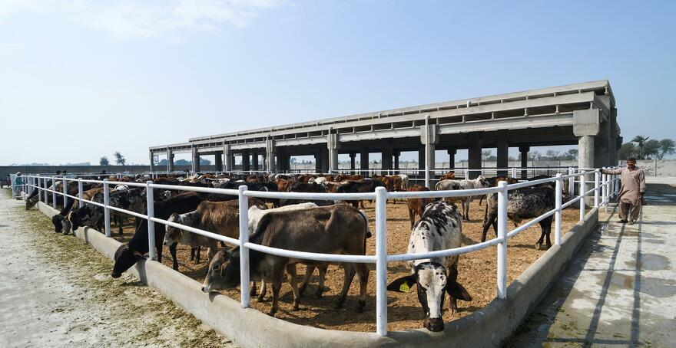
EXISTING SOLUTIONS
Highly sophisticated fences are arranged around the sheds.
By GPS and GPRS sensors the shepherd gets the notification to his mobile through satellite technology.

Slide 6
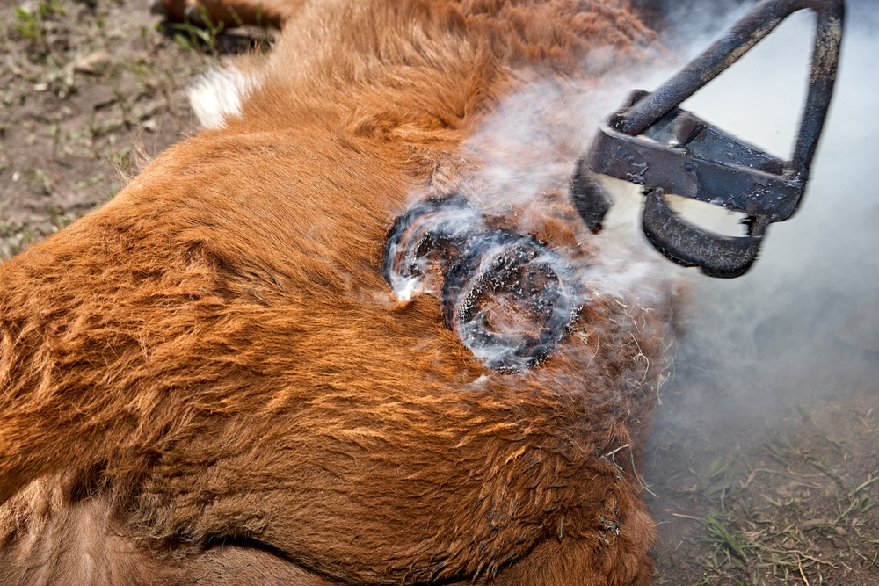
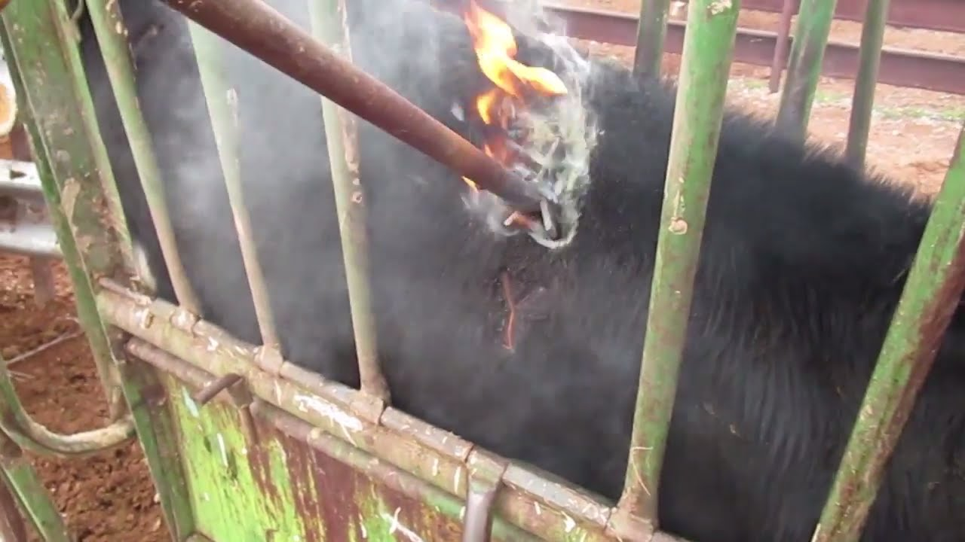
▪ By branding technique they identify them.

Slide 7
DISADVANTAGES OF EXISTING SOLUTION
A type of sensor boundary can be arranged which informs the cattle
the shepherd/cattle’s owner by generating an alarm in his/her mobile when the cattle tries to cross the boundary of the shed.
If the cattlemen doesn’t react for the alarm then the alarm sensor which is at thee shed gets activated.
In this ultrasonic sensors and alarm sensors are taken in to action.
By the cattlemen gets information to make them alert .
Hence this is also affordable by the small shepherds/cattle rearers.

Slide 8
Proposed Solution:
A type of sensor boundary can be arranged which informs the cattle
the shepherd/cattle’s owner by generating an alarm in his/her mobile when the cattle tries to cross the boundary of the shed.
If the cattlemen doesn’t react for the alarm then the alarm sensor which is at thee shed gets activated.
In this ultrasonic sensors and alarm sensors are taken in to action.
By the cattlemen gets information to make them alert .
Hence this is also affordable by the small shepherds/cattle rearers.

Slide 9
Advantages of our solution:
It is quite cheaper than the advanced technologies which are being widely used.
Like in some cases the symbol are imprinted on the animal’s body to identify it. There is no such question.
Awareness and care taking of the cattle by their shepherds/cattlemen is made easy.
Not only in the case of escaping of the cattle but also in case like fire breakout in the cattle it gets alerts more faster then before.

Slide 10
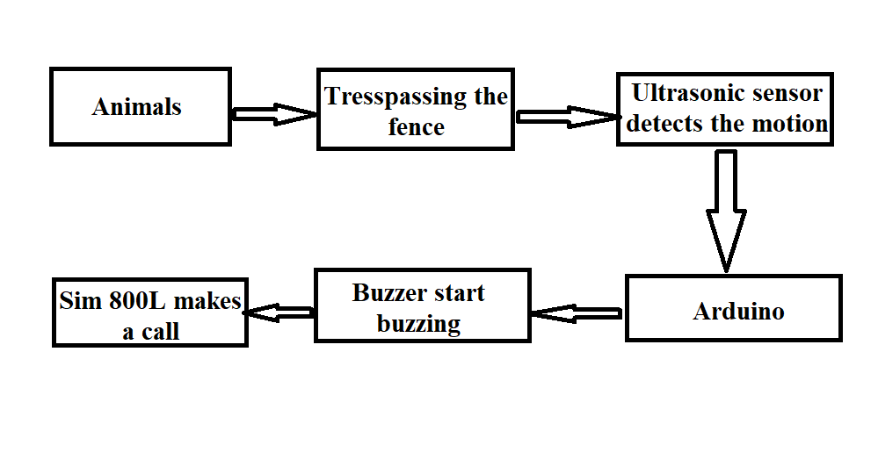
Block Diagram

Slide 11
References
"Live Animals". FAO. Food and Agriculture Organization of the United Nations. Archived from the original on 31 August 2020. Retrieved 31 August 2020.
"FAO – News Article: Key facts and findings". www.fao.org. Retrieved 4 June 2021.
"Treating beef like coal would make a big dent in greenhouse-gas emissions". The Economist. 2 October 2021. ISSN 0013-0613. Retrieved 3 November 2021.
Brown, David (23 April 2009). "Scientists Unravel Genome of the Cow". The Washington Post. Archived from the original on 28 June 2011. Retrieved 23 April 2009.
Ajmone-Marsan, Paolo; Garcia, J.F; Lenstra, Johannes (January 2010). "On the origin of cattle: How aurochs became domestic and colonized the world". Evolutionary Anthropology. 19: 148–157. doi:10.1002/evan.20267. S2CID 86035650. Archived from the original on 4 December 2017. Retrieved 3 December 2017.
Grubb, P. (2005). "Bos taurus". In Wilson, D.E.; Reeder, D.M (eds.). Mammal Species of the World: A Taxonomic and Geographic Reference (3rd ed.). Johns Hopkins University Press. pp. 637–722. ISBN 978-0-8018-8221-0. OCLC 62265494.
"Explore the Database". www.mammaldiversity.org. Retrieved 21 August 2021.

Slide 12
Conclusion
We , as a team , just want the shepherds to take advantage by using our equipment.
Our equipment also uses multiple technologies in different aspects of it's functioning.
We are also thinking to make this project with all quality materials and also with less expenditure.
This project also enables shepherds to help the trade of cattle.

